Slide 1
VOLUNTEER TRAINING

Slide 2
What is Apply Yourself Florida?
Part of the national American College Application Campaign
Aims to increase the number of low-income and first-generation students pursuing a college degree or other high-quality credential
Promotes a college-going culture for all students
Provides high school seniors the opportunity to apply to college(s) of their choice during the regular school day, with the support of volunteers

Slide 3
Overview of the Application Event
Computer lab is prepared for students
Students arrive and receive instruction sheet
Students complete applications, with assistance from volunteers as needed
Students print up confirmation page for their records
Students complete sign-out sheet (or report # of apps completed) and get “I Applied!” sticker. (If there are any other handouts for students, they can also be distributed now.)

Slide 4
Volunteer Roles
Greeting students as they enter the lab.
Answer general questions about the application process.
Monitor printers to ensure they work and have enough paper.
Share personal experience of applying to college.
Pass out “You Applied! Now What?” handouts and/or FAFSA flyers.
Monitor sign-out process and hand out “I Applied!” stickers.

Slide 5
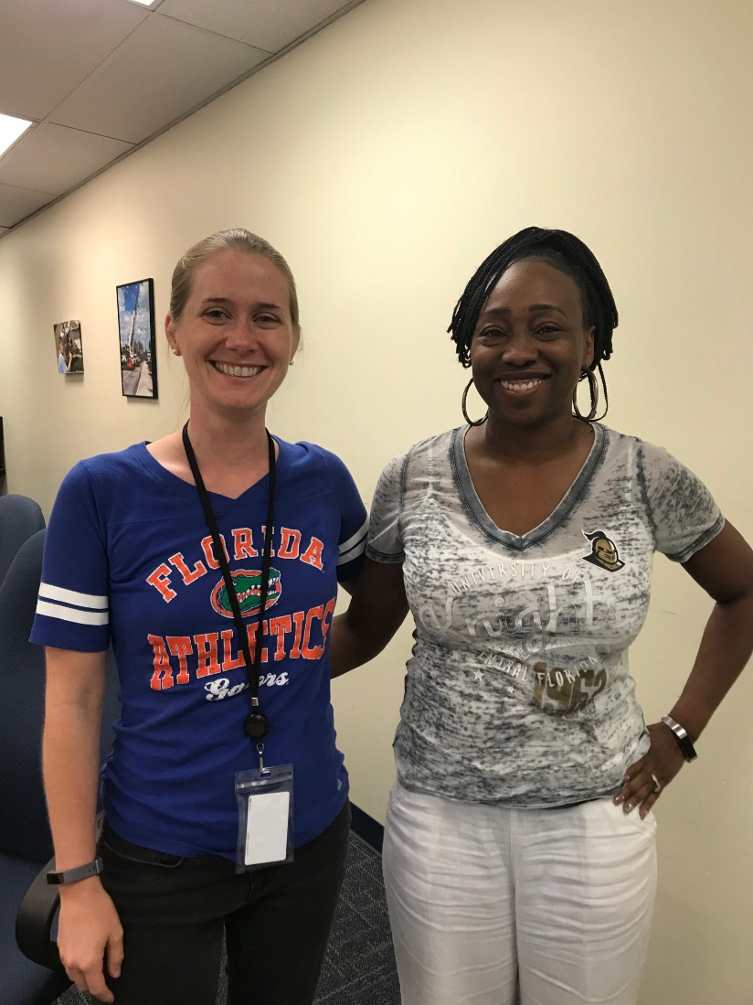
General Guidelines
Please use appropriate language and model good behavior.
Be mindful of any physical contact with students!
Volunteers and Site Coordinators should work together as a team.
Be supportive of students’ choice of schools (regardless of your personal feelings on the school).
Volunteers are highly encouraged to wear a college shirt.

Slide 6
The Application Process
Research colleges based on match & fit
Determine application requirements
Take required admissions test, if you haven’t already done so
Gather information needed to apply
(use the College Application Worksheet)
Prepare/request any supplemental materials
(essays, recommendations, transcripts)
Complete and submit application form
Follow-up with any required materials or interviews
Should already be completed before the event
Notes:
College Application Worksheet can be found in the Apply Yourself Student Guide

Slide 7
Application FAQs

Slide 8
Types of Admission Processes
Regular Decision: Students submit an application by a specified date and receive a decision in a clearly stated period of time.
Rolling Admission: Institutions review applications as they are submitted and render decisions throughout the admission cycle.
Early Action (EA): Students apply early and receive a decision well in advance of the institution’s regular response date.
Early Decision (ED): Students make a commitment to a first-choice institution where, if admitted, they definitely will enroll. The application deadline and decision deadline occur early.
Restrictive Early Action (REA): Students apply to an institution of preference and receive a decision early. They may be restricted from applying ED, EA or REA to other institutions. If offered enrollment, they have until May 1 to confirm.

Slide 9
Unfamiliar Terms/Abbreviations
SSN | Social Security Number
Surname | Last name
Term of Entry | When the student is seeking admission for (traditionally August, January, May, or June)
Legacy Student | Someone whose parent(s) attended and/or graduated from the institution that the student is applying
Waiver of Access | A student waiving their right to review their letters of recommendation. (FERPA)
Gross Income | Total income and revenue from all sources (other wages, salaries, profits, interest payments, rents, and other forms of earnings)
Permanent mailing address | Where the student permanently resides (usually their parent’s home address)
Local mailing address | The present place of residence (i.e. dorm address, apartment address)
Matriculation | Enrolling as a student at a college or university
Source: National Association for College Admission Counseling (NACAC)

Slide 10
Important Tips
LEGAL NAME:
Essential that name is accurately reported (same as on social security card); often a place to mark if student uses other names
APPLYING AS:
Freshman or freshman with dual enrollment courses; NOT transfer
INSTITUTIONS ATTENDED:
Dual enrollment included
SOCIAL SECURITY NUMBER:
Enter accurate social security number. If the student does not have a social security number, they should enter 000-00-0000.
ACADEMIC VIOLATIONS/VIOLATIONS OF THE LAW:
Important to respond honestly—a “yes” response does not mean the application is automatically rejected.

Slide 11
Determining Residency
DEPENDENT vs. INDEPENDENT
Most students will claim residency as a dependent, as defined for tax purposes.
CLAIMANT
Claimant is not always Student (!!!). If the student is a dependent, the claimant is their parent/legal guardian. This part of the application requires the parent/legal guardian’s information and documents. If a student was independent, they would complete the form with their own information.

Slide 12
Paying the Application Fee
Preferred method is by credit card before submitting the application.
If they are using a check or money order, the application is not considered complete until payment is submitted.
If they are using a fee waiver, they may upload a scanned copy to the application itself or send in the fee waiver separately depending on the school.
Information on how to submit waivers to each Florida state university is in the “Apply Yourself Student Guide”
Notes:
Apply Yourself Student Guide available on FCAN’s website for download

Slide 13
Special Situations
Please be aware that some students attending the event may be facing special situations:
Homeless students
Students in foster care
Undocumented students
Independent students
Please refer any specific questions to the site coordinator and/or school counselor.

Slide 14
#WhyApply Day
September 16, 2022
Join the American College Application Campaign virtually on Sept. 16 as we kick off the college application season.
Head to your favorite social media channels and answer the question “Why apply to college?” Help inspire students as they begin the college application process.
Be sure to use the hashtag #WhyApply and wear your college gear!

Slide 15
THANK YOU FOR VOLUNTEERING!

